Slide 1
WEEK -05 LECTURE
PARALLEL AND DISTRIBUTED COMPUTING

Slide 2
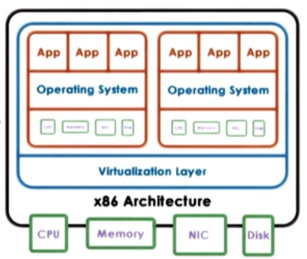
Virtualization
Virtualization allows concurrent execution of multiple OSs and their applications on the same physical machine.
Virtual resources : each OS thinks that "owns" hardware resources
Virtual machine (VM) : OS + applications + virtual resources (guest domain)
Virtualization layer : management of physical hardware (virtual machine monitor, hypervisor)

Slide 3
Virualization Continue..
A Virtual Machine is an efficient, isolated duplicate of the real machine.
Supported by a Virtual Machine Monitor (VMM):
provides environment essentially identical with the original machine
programs show only minor decrease in speed at worst
VMM is in complete control of the system resources
VMM goals
Fidelity
Performance
Safety and Isolation
Virtualization advantages
consolidation
decrease cost, improve manageability
migration
availibility, reliability
security, debugging, support for legacy OS

Slide 4
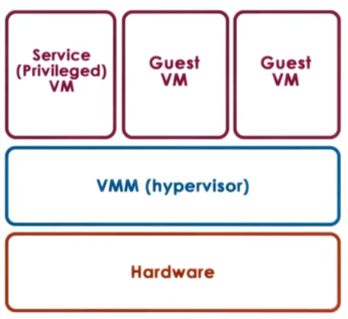
Two main Virtualization Models:
1. Bare-metal or Hypervisor based (Type 1)
VMM (hypervisor) manages all hardware resources abd supports execution of VMs
privileged, secure VM to deal with devices (and other configuration and management tasks)
Adopted by Xen(Opensource or Citriol Xen Server) and ESX (VMware)

Slide 5
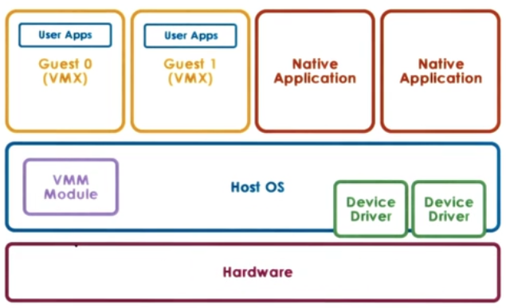
Hosted (Type 2)
Host owns all hardware
Special VMM modle provides hardware interfaces to VMs and deals with VM context switching

Slide 6
Full Virtualization vs Partial Virtualization
In Full virtualization, virtual machine permit the execution of the instructions with running of unmodified OS in an entire isolated way. In paravirtualization, virtual machine does not implement full isolation of OS but rather provides a different API which is utilized when OS is subjected to alteration
In Partial virtualization multiple instances of an underlying hardware environment are simulated. It is not mandatory that in para virtualization, it simulates hardware. It may provide an API, which can be exceptionally used by altering the guest operating systems.
Full virtualization is a virtualization technique used to provide a VME that completely simulates the underlying hardware. In this type of environment, any software capable of execution on the physical hardware can be run in the VM, and any OS supported by the underlying hardware can be run in each individual VM.

Slide 7
Device Virtualization (Pass-through, Hypervisor-Direct, and Split Device Driver)
Device Virtualization
For CPUs and Memory
less diversity, Instruction-Set-Architecture(ISA) level
Standardization of interface
For Devices
high diversity
lack of standard specification of device interface and behavior

Slide 8
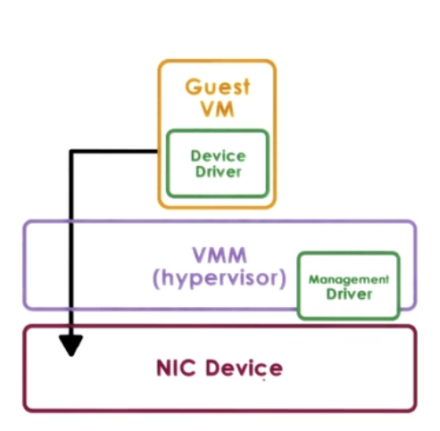
Pass through model
Approach: VMM-level-driver configures device access permissions
Advantages
VM provided with exclusive and direct (VMM bypass) access to the device
Disadvantages
Device sharing difficult
VMM must have exact type of device as what VM expects
VM migration tricky

Slide 9
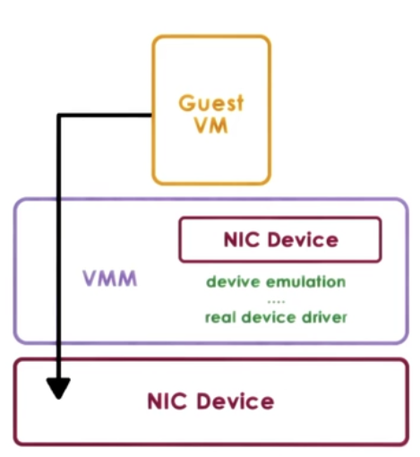
Hypervisor - Direct model
Approach:
VMM interrupts all device accesses
Emulate device operations
translate to generic I/O operations
traverse VMM-resident I/O stack
invoke VMM-resident driver
Advantages
VM decoupled from physical device
Sharing, migration, dealing with device specifics
Disadvantages
Latency of device operations
Device driver ecosystem complexities in Hypervisor

Slide 10
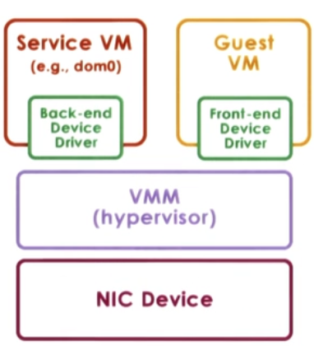
Split Device-Driver model
Approach:
Device access control split between
Emulate device operations
front-end driver in guest VM (device API)
back-end driver in service VM (or Host)
modified guest drivers
i.e. limited to paravirtualized guests
Advantages
Eliminate emulation overhead
Allow for better management of shared devices

Slide 11
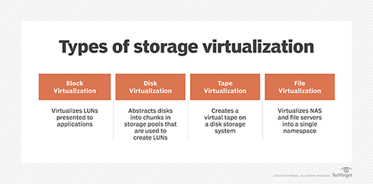
Network and Storage Virtualization
Storage virtualization is the process of grouping the physical storage from multiple network storage devices so that it looks like a single storage device.
Network-based storage virtualization is the most common form used in enterprises today. A network device, such as a smart switch or purpose-built server, connects to all storage devices in and presents the storage in the storage network as a single, virtual pool.
Host-based storage virtualization.
Array-based storage virtualization.
OS-level storage virtualization.
File-system virtualization.
Fibre Channel storage virtualization.

Slide 12
Software Defined Networks (SDN) and Software Defined Storage (SDS)
Software-defined networking technology is an approach to network management that enables dynamic, programmatically efficient network configuration in order to improve network performance and monitoring, making it more like cloud computing than traditional network management.
The history of SDN principles can be traced back to the separation of the control and data plane first used in the public switched telephone network as a way to simplify provisioning and management well before this architecture began to be used in data networks.
Software-defined storage (SDS) is a storage architecture that separates storage software from its hardware.
Software-defined storage is an approach to data management "Software-Defined Storage." SDS is software that manages data storage devices. It is commonly used for managing large amounts of data in data centers, server farms, and enterprise environments. SDS functions independently of the underlying hardware.

